Slide 1



Introduction to R and RStudio
Session 6: Naming Objects

Slide 2
Let’s revisit our dplyr session:
beds_data %>%
group_by(date) %>%
summarise(
mean_beds = mean(beds_av, na.rm = T))
The mean number of beds available by date:
Output = Object = New data frame!

Slide 3
Next step: Visualise

Slide 4
Piecing it together
beds_data %>%
group_by(date) %>%
summarise(
mean_beds = mean(beds_av, na.rm = T))
ggplot(data = )
Output = Object = New data frame!

Slide 5
Now, we could do this:
ggplot(data = beds_data %>%
group_by(date) %>%
summarise(
mean_beds = mean(beds_av, na.rm = T))
)+
geom_...

Slide 6
But, it’s often better to:
Keep wrangling separate

Slide 7
And it’s always better to:
Keep your code readable
as possible
as

Slide 8
Solution:
beds_data %>%
group_by(date) %>%
summarise(
mean_beds = mean(beds_av, na.rm = T))
name

Slide 9
Replace this:
beds_data %>%
group_by(date) %>%
summarise(
mean_beds = mean(beds_av, na.rm = T))

Slide 10
With this:
name

Slide 11
Naming
beds_data %>%
group_by(date) %>%
summarise(
mean_beds = mean(beds_av, na.rm = T))
naming is hard

Slide 12
Naming
beds_data %>%
group_by(date) %>%
summarise(
mean_beds = mean(beds_av, na.rm = T))
Murray

Slide 13
Naming
beds_data %>%
group_by(date) %>%
summarise(
mean_beds = mean(beds_av, na.rm = T))
Murray

Slide 14
Good (object) names are:
Descriptive
Short(ish)
Consistent with other names

Slide 15
Naming?
beds_data %>%
group_by(date) %>%
summarise(
mean_beds = mean(beds_av, na.rm = T))
beds_ts

Slide 16
Assignment
Name objects with the assignment operator:
beds_ts <- beds_data %>%
group_by(date) %>%
summarise(
mean_beds = mean(beds_av, na.rm = T))
assignment operator

Slide 17
Assignment operator
Shortcut: Alt -

Slide 18
Assignment
beds_ts <- beds_data %>%
group_by(date) %>%
summarise(
mean_beds = mean(beds_av, na.rm = T))
Assigns this name…

Slide 19
Assignment
beds_ts <- beds_data %>%
group_by(date) %>%
summarise(
mean_beds = mean(beds_av, na.rm = T))
Assigns this name…
To the object produced by this code

Slide 20
Assignment
beds_ts <- beds_data %>%
group_by(date) %>%
summarise(
mean_beds = mean(beds_av, na.rm = T))
beds_ts
running beds_ts recalls data frame above

Slide 21
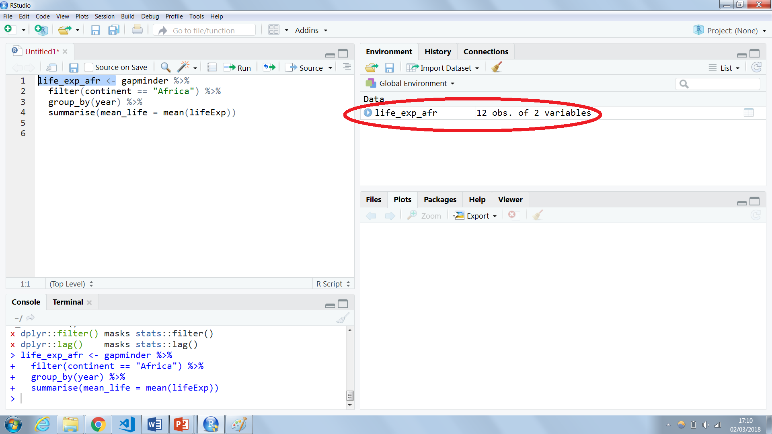
Objects
Objects you have created can be seen in the Environment pane

Slide 22
Returning to the plot:
ggplot(data = beds_data %>%
group_by(date) %>%
summarise(
mean_beds = mean(beds_av, na.rm = T)))+
geom_...(aes(x = …, y = …))

Slide 23
Becomes:
ggplot(data = beds_ts)+
geom_...(aes(x = …, y = …))

Slide 24
Or:
ggplot(beds_ts)+
geom_...(aes(…, …))

Slide 25
Your turn (1)
If you haven’t already, follow the steps we’ve just covered to create the object beds_ts.

Slide 26
Your turn (2)
Plot the trend in mean available beds. You may require ggplot(…) plus + the following layers:
geom_line(aes(… , …))+
geom_point(…(… , …))+
ylim(… , …)
To get help with this (or any) function type
?ylim

Slide 27
Your turn (3)
Give your plot object a name.

Slide 28
To summarise
Give an object (data frame, plot, value) a name when you may need that object later in your analysis.

Slide 29
This material was created for the NHS-R community by:
Andrew Jones @The Strategy Unit
The work is licenced under:
Creative Commons
Attribution-ShareAlike 4.0
International
To view a copy of this license, visit
https://creativecommons.org/licenses/by-sa/4.0/

Slide 30
End

